Slide 1
Planning in the Continuous Domain: a Generalized
Belief Space Approach for Autonomous Navigation in
Unknown Environments
Vadim Indelman, Luca Carlone , and Frank Dellaert
International Journal of Robotics Research - 2015
Indelman, V., Carlone, L., and Dellaert, F. (2013). Towards planning in generalized belief space. In Proc. of the Intl. Symp. of Robotics Research (ISRR).
Indelman, V., Carlone, L., and Dellaert, F. (2014). Planning under uncertainty in the continuous domain: a generalized belief space approach. In IEEE Intl. Conf. on Robotics and Automation (ICRA).
Dan and Alon

Slide 2
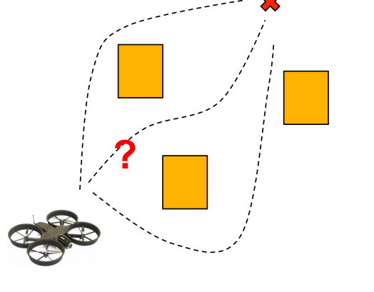
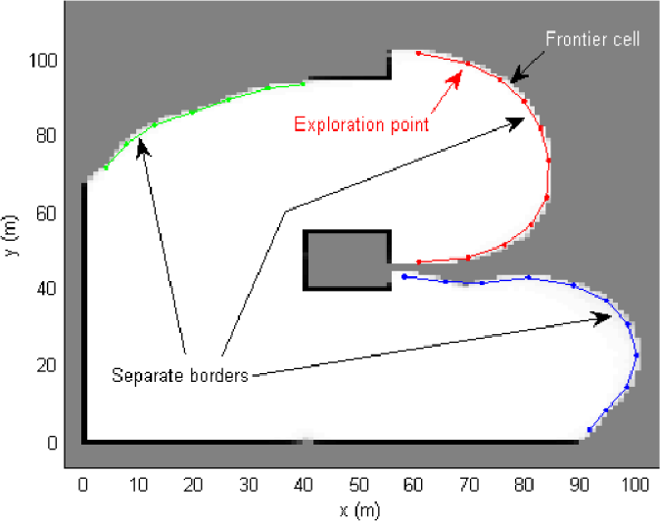
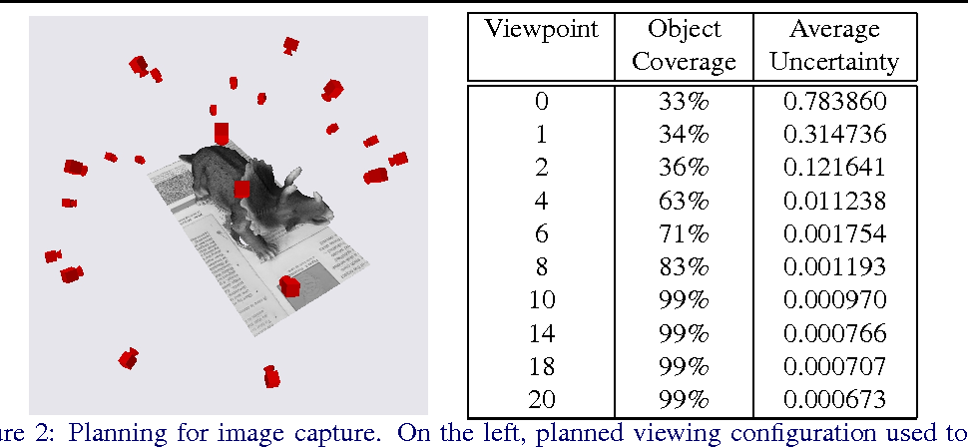
Problem Statement
Formulate a general strategy to accomplish common tasks in robotics in the following setting:
No prior knowledge
Continuous Domain (as opposed to discrete)
Maximum Likelihood Observations
Path Planning
Exploration
Next Best View

Slide 3
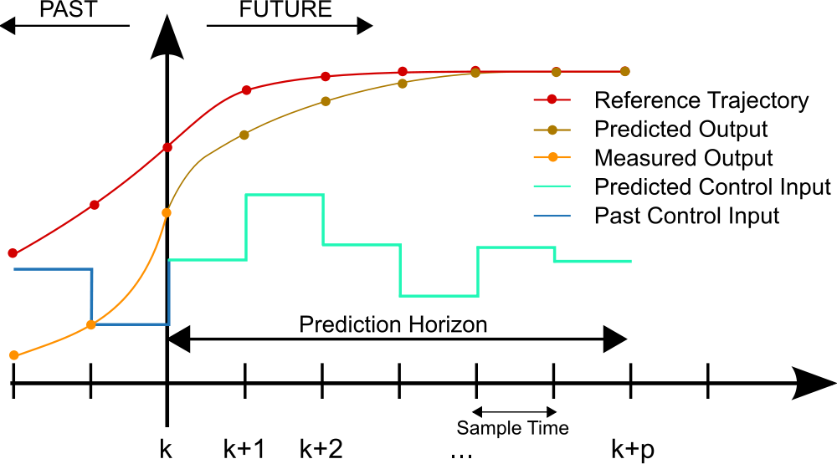
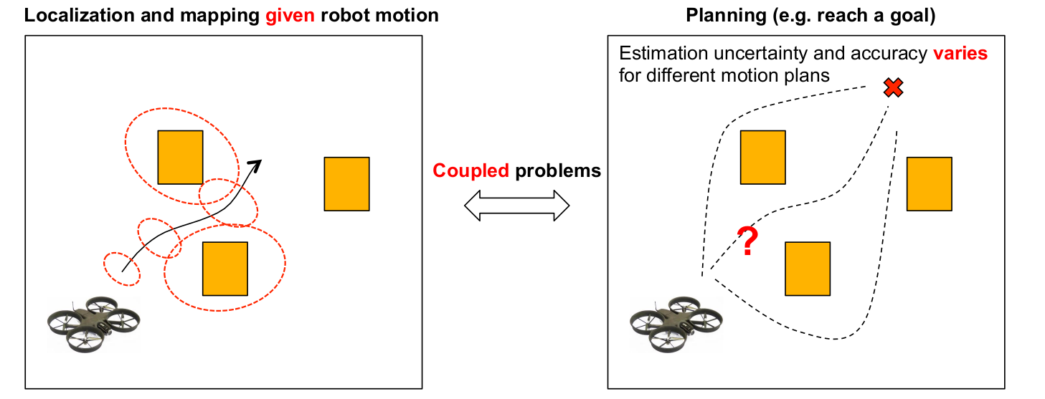
Approach:
Model Predictive Controller
Plan with the Estimation in mind

Slide 4
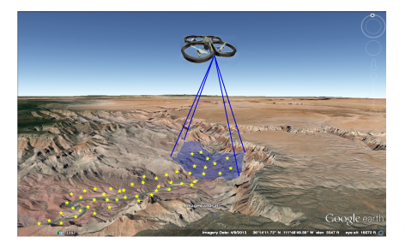
Motivating Example Used:
UAV flies over an unknown region with a camera looking downwards.
Its goal is to reach pre-specified goal positions while preserving an acceptable localization error
Notes:
UAV in an unknown

Slide 5
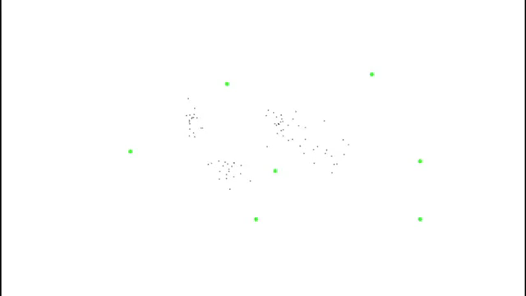

Slide 6
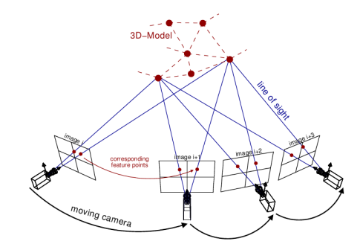
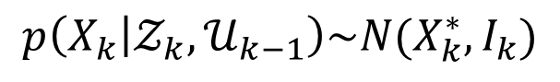
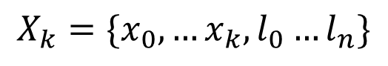
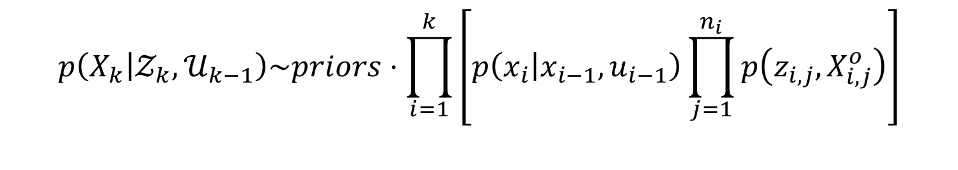
Plan with Estimation in Mind:
As the environment is unknown, a joint state vector is held:
$$X_{k}=\{x_{0},…x_{k},l_{0}…l_{n}\}$$
robot poses
landmarks
Estimation over the joint probability:
$$p\left(X_{k} | 𝒵_{k},𝒰_{k−1}\right)\sim priors⋅\prod_{i=1}^{k}{\left[p\left(x_{i} | x_{i−1},u_{i−1}\right)\prod_{j=1}^{n_{i}}{p\left(z_{i,j},X_{i,j}^{o}\right)}\right]}$$
Motion model
Observation model
Architect models such that the posterior can be modeled as a gaussian:
$$p\left(X_{k} | 𝒵_{k},𝒰_{k−1}\right)\sim N(X_{k}^{∗},I_{k})$$
Information Matrix

Slide 7
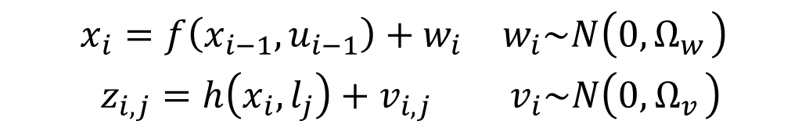
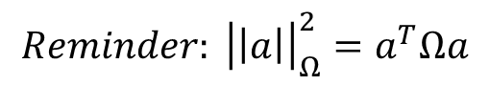
Solving for the posterior distribution via Expectation Maximization:
$$X_{k}^{∗}=\underset{X_{k}}{argmax} p\left(X_{k} | 𝒵_{k},𝒰_{k−1}\right)=\underset{X_{k}}{argmin}\left\{−\log\left(p\left(X_{k} | 𝒵_{k},𝒰_{k−1}\right)\right)\right\}$$
$$\begin{matrix}x_{i}=f\left(x_{i−1},u_{i−1}\right)+w_{i} & w_{i}\sim N\left(0,Ω_{w_{ }}\right) \\ z_{i,j}=h\left(x_{i},l_{j}\right)+v_{i,j} & v_{i}\sim N\left(0,Ω_{v_{ }}\right)\end{matrix}$$
$$X_{K}^{∗}=\underset{X_{k}}{argmin} \left\{{\left|\left|x−{\hat{x}}_{0}\right|\right|}_{Ω_{0}}^{2}+\sum_{i}{\left[{\left|\left|x_{i}−f\left(x_{i−1},u_{i−1}\right)\right|\right|}_{{Ω_{w}}_{i}}^{2}+\sum_{j=ℳ_{i}}{{\left|\left|z_{i,j}−h\left(x_{i},l_{j}\right)\right|\right|}_{{Ω_{v}}_{i,j}}^{2}}\right] }\right\}$$
Prior
Motion Models
Observation models
$$Reminder: {\left|\left|a\right|\right|}_{Ω}^{2}=a^{T}Ωa$$

Slide 8

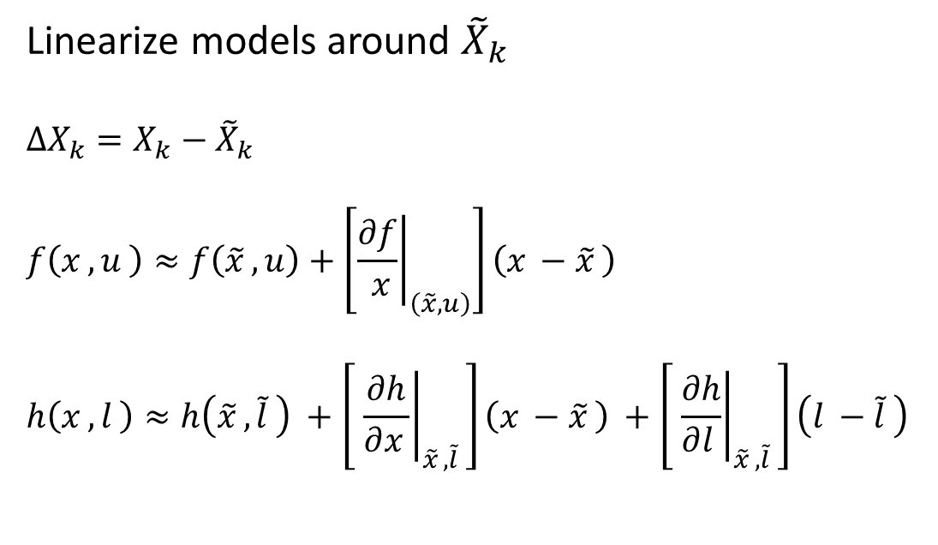
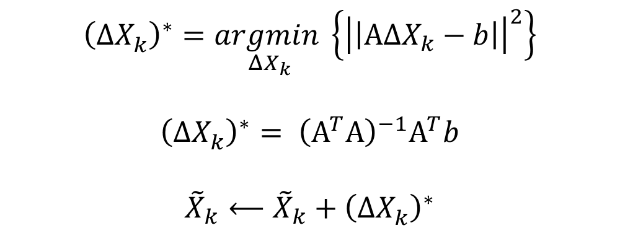
Solving for the posterior distribution via Expectation Maximization:
$$X_{K}^{∗}=\underset{X_{k}}{argmin} \left\{{\left|\left|x−{\hat{x}}_{0}\right|\right|}_{Ω_{0}}^{2}+\sum_{i}{\left[{\left|\left|x_{i}−f\left(x_{i−1},u_{i−1}\right)\right|\right|}_{{Ω_{w}}_{i}}^{2}+\sum_{j=ℳ_{i}}{{\left|\left|z_{i,j}−h\left(x_{i},l_{j}\right)\right|\right|}_{{Ω_{v}}_{i,j}}^{2}}\right] }\right\}$$
Linearize models around ${\tilde{X}}_{k}$
$$ΔX_{k}=X_{k}−{\tilde{X}}_{k}$$
$$f\left(x_{ },u_{ }\right)≈f\left({\tilde{x}}_{ },u\right)+\left[{\left.\frac{∂f}{ x}\right|}_{\left(\tilde{x}, u\right)}\right]\left(x_{ }−{\tilde{x}}_{ }\right)$$
$$h\left(x_{ },l_{ }\right)≈h\left({\tilde{x}}_{ },{\tilde{l}}_{ }\right) +\left[ {\left.\frac{∂h}{∂x_{ }}\right|}_{{\tilde{x}}_{ },{\tilde{l}}_{ }}\right]\left(x_{ }−{\tilde{x}}_{ }\right) +\left[ {\left.\frac{∂h}{∂l_{ }}\right|}_{{\tilde{x}}_{ },{\tilde{l}}_{ }}\right]\left(l_{ }−{\tilde{l}}_{ }\right)$$
$${\left(ΔX_{k}^{ }\right)}^{∗}=\underset{ΔX_{k}}{argmin}\left\{{\left|\left|ΑΔX_{k}−b\right|\right|}^{2}\right\}$$
$${\left(ΔX_{k}^{ }\right)}^{∗}= {\left(Α^{T}Α\right)}^{−1}Α^{T}b$$
$${\tilde{X}}_{k}⟵{\tilde{X}}_{k}+{\left(ΔX_{k}^{ }\right)}^{∗}$$
Do this until convergence

Slide 9
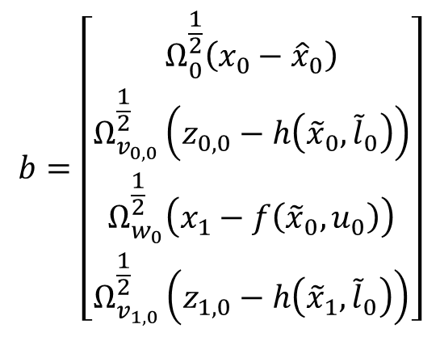
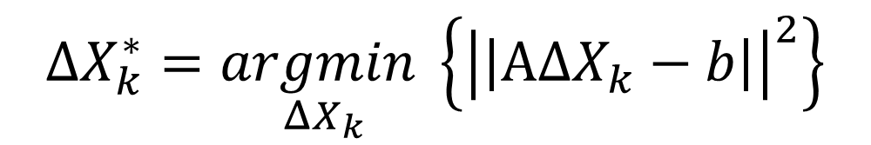
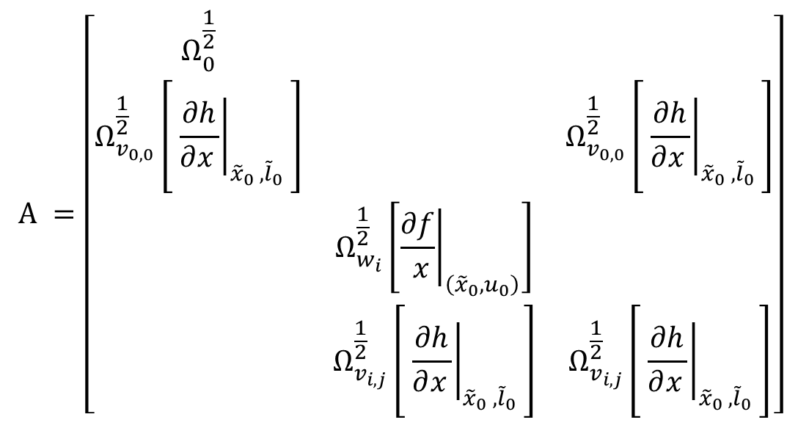
Solving for the posterior distribution via Expectation Maximization:
$$ΔX_{k}^{∗}=\underset{ΔX_{k}}{argmin}\left\{{\left|\left|ΑΔX_{k}−b\right|\right|}^{2}\right\}$$
$$Α =\left[\begin{matrix}Ω_{0}^{\frac{1}{2}} & & \\ Ω_{v_{0,0}}^{\frac{1}{2}}\left[ {\left.\frac{∂h}{∂x_{ }}\right|}_{{{\tilde{x}}_{0}}_{ },{{\tilde{l}}_{0}}_{ }}\right] & & Ω_{v_{0,0}}^{\frac{1}{2}}\left[ {\left.\frac{∂h}{∂x_{ }}\right|}_{{{\tilde{x}}_{0}}_{ },{{\tilde{l}}_{0}}_{ }}\right] \\ & Ω_{w_{i}}^{\frac{1}{2}}\left[{\left.\frac{∂f}{ x}\right|}_{\left({\tilde{x}}_{0}, u_{0}\right)}\right] & \\ & Ω_{v_{i,j}}^{\frac{1}{2}}\left[ {\left.\frac{∂h}{∂x_{ }}\right|}_{{{\tilde{x}}_{0}}_{ },{{\tilde{l}}_{0}}_{ }}\right] & Ω_{v_{i,j}}^{\frac{1}{2}}\left[ {\left.\frac{∂h}{∂x_{ }}\right|}_{{{\tilde{x}}_{0}}_{ },{{\tilde{l}}_{0}}_{ }}\right]\end{matrix}\right]$$
$$b=\left[\begin{matrix}Ω_{0}^{\frac{1}{2}}\left(x_{0}−{\hat{x}}_{0}\right) \\ Ω_{v_{0,0}}^{\frac{1}{2}}\left(z_{0,0}−h\left({\tilde{x}}_{0},{\tilde{l}}_{0}\right)\right) \\ Ω_{w_{0}}^{\frac{1}{2}}\left(x_{1}−f\left({\tilde{x}}_{0},u_{0}\right)\right) \\ Ω_{v_{1,0}}^{\frac{1}{2}}\left(z_{1,0}−h\left({\tilde{x}}_{1},{\tilde{l}}_{0}\right)\right)\end{matrix}\right]$$
Whitened errors
Whitened Jacobians
Not a function of the measurements (at first iteration)

Slide 10
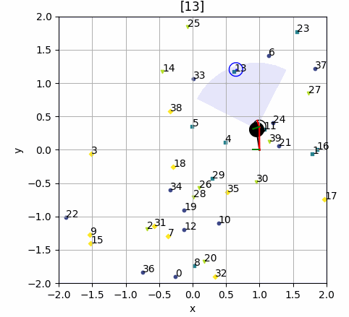
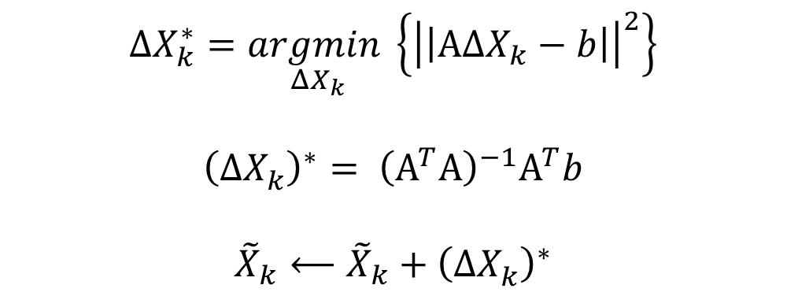
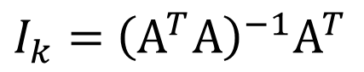
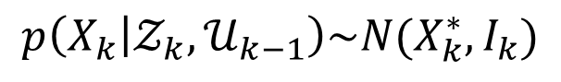
Solving for the posterior distribution via Expectation Maximization:
$$p\left(X_{k} | 𝒵_{k},𝒰_{k−1}\right)\sim N(X_{k}^{∗},I_{k})$$
$$ΔX_{k}^{∗}=\underset{ΔX_{k}}{argmin}\left\{{\left|\left|ΑΔX_{k}−b\right|\right|}^{2}\right\}$$
$${\left(ΔX_{k}^{ }\right)}^{∗}= {\left(Α^{T}Α\right)}^{−1}Α^{T}b$$
$${\tilde{X}}_{k}⟵{\tilde{X}}_{k}+{\left(ΔX_{k}^{ }\right)}^{∗}$$
$I_{k}=$ ${\left(Α^{T}Α\right)}^{−1}Α^{T}$
Do this until convergence

Slide 11
Planning in the Generalized Belief Space

Slide 13
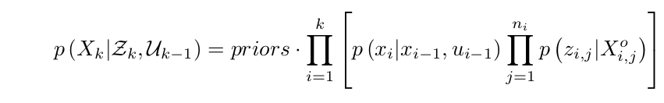
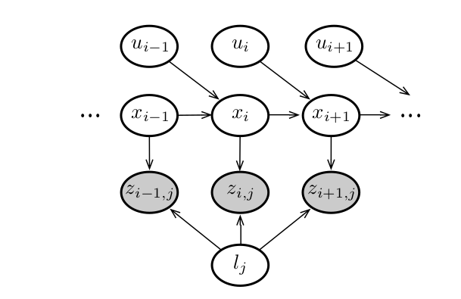
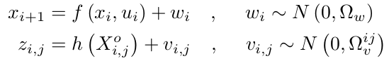

Slide 14
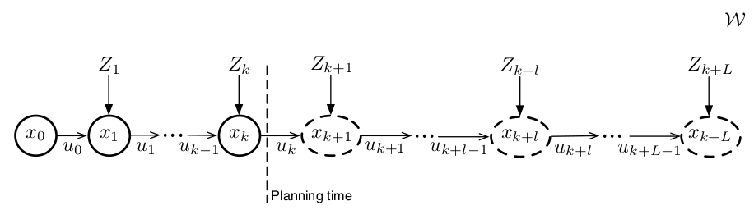
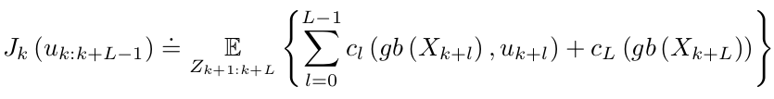
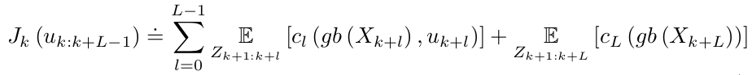

Slide 15
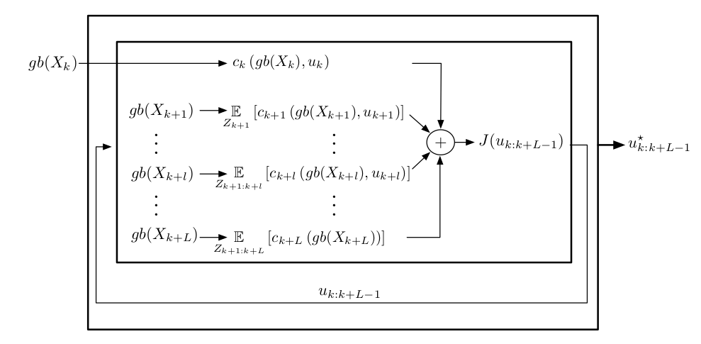
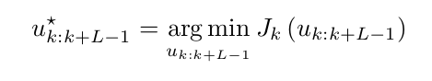
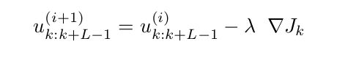

Slide 16
